Slide 1
Architectural and Engineering Professions
Notes:
Today we are going to learn more about a few of the jobs that are available in the architectural and engineering fields. We mentioned a few of these in the Wordle, but there may be one or two that none of you through about.

Slide 2
Standards
2.1 Identify the professional and/or trade associations related to the architectural and engineering professions.
2.2 Identify related occupations within the architectural and engineering professions.
2.3 Identify employment opportunities in the architectural and engineering profession.
2.4 Match architectural and engineering occupational job titles with qualifications and responsibilities.
2.5 Identify education and training required to work in the various architectural and engineering professions.
2.6 Participate in activities related to career interest.
Notes:
Standards:
These are the standards that have been put forth by the state department.
After this unit, you should be able to participate and complete each one of these standards.
2.1 Identify the professional and/or trade associations related to the architectural and engineering professions.
2.2 Identify related occupations within the architectural and engineering professions.
2.3 Identify employment opportunities in the architectural and engineering profession.
2.4 Match architectural and engineering occupational job titles with qualifications and responsibilities.
2.5 Identify education and training required to work in the various architectural and engineering professions.
2.6 Participate in activities related to career interest.

Slide 3
Essential Questions (EQ’s)
What are the different types of engineering?
Why are architectural and engineering professions so important?
How are the professions within these fields different? How are they similar?
Notes:
We have three essential questions for this unit:
What are the different types of engineering?
Why are architectural and engineering professions so important?
How are the professions within these fields different? How are they similar?
You need to be able to answer these questions by the time we are finished with our unit this week

Slide 4
Why do we need architectural and engineering jobs?
Architectural and Engineering jobs provide us with new buildings, vehicles, bridges and other items that we use every day.
Not only do they create new items for us, but they also improve upon the ones that already exist.
Notes:
So why do we need architectural and engineering jobs?
Well how many of you like the houses that you live in?
The cars that your parents drive?
The food that you eat?
The football stadium that you sit in on Friday night?
All of these things were designed by architects and engineers.
Architectural and Engineering jobs provide us with new buildings, vehicles, bridges and other items that we use on a daily basis
Now I know most of you are thinking, well engineers can’t design a head of lettuce or a carrot or a pineapple and you would be correct.
There are engineering jobs that take the items that we already have today, such as fruits and vegetables and make them better for us.

Slide 5
Major Jobs
Architect
Civil Engineer
Electrical Engineer
Mechanical Engineer
Biomedical Engineer
Notes:
We are going to briefly cover five jobs within the architectural and engineering fields:
Architect, Civil Engineer, Electrical Engineer, Mechanical Engineer, and Biomedical Engineer

Slide 6
Architect
Architects work alongside engineers, technicians and clients to design houses, office buildings, and other structures.
To be an architect you must obtain a bachelor’s degree from an accredited university
Georgia Tech, SCAD
Most architects work in an office where they meet with clients and consult with engineers
The average salary for architects is $73,000 per year
Notes:
So what does an architect do
Architects work alongside engineers, technicians and clients to design houses, office buildings, and other structures.
To be an architect you must obtain a bachelor’s degree (a four year degree) from an accredited university.
Some of those places located in Georgia are Georgia tech in Atlanta and the Savannah College of Art and Design
There are other places outside of Georgia that you can get an architectural degree as well.
Most architects work in an office where they meet the clients and find out what their needs and wants are in a project.
They also consult with engineers to make sure that the project is done to code and done correctly the first time.
How much do you think an architect makes a year?
$73,000 a year

Slide 7
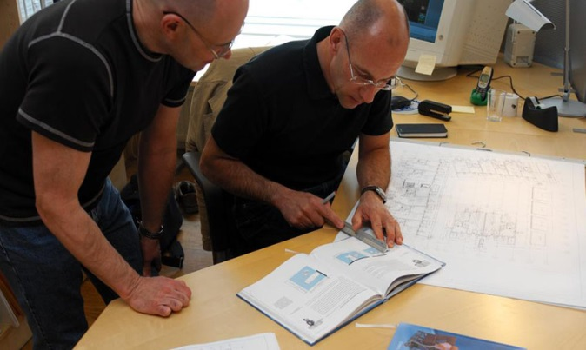
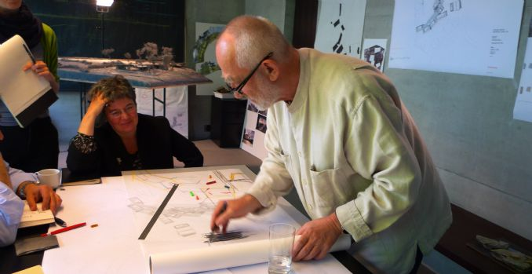
Notes:
Pictures
These are a few pictures that show just what architects do
You have several of them creating drawings for a project.
The top left picture is showing a consultation between an architect and a client
When an architect meets with a client they have to make sure that the client is happy but they also have to think about the safety of the project and making sure that the building or bridge they are designing doesn’t come crashing down.
The bottom right picture is a 3-D computer drawing of a building. This is the picture that the architect would show to client to make sure that the building looks the way the client wants it to before they start with the project.

Slide 8
Civil Engineer
Design, construct, supervise, operate and maintain large infrastructure such as highways, railways, airports, bridges, dams, and tunnels.
To become a civil engineer, you must obtain a degree from a university
Georgia Tech, UGA, Georgia Southern University
Civil Engineers work mostly in an office but may venture out to the work cite of different projects.
The average salary for a civil engineer is $80,000 per year
Notes:
Now most of you have probably heard of civil engineering
Civil engineers design, construct, supervise, operate and maintain large infrastructure such as highways, railways, airports, bridges, dams and tunnels
Just like with architecture, to be a civil engineer you have to have a bachelor’s degree.
In the state of Georgia you can get a civil engineering degree from Georgia Tech, Georgia Southern University and UGA
UGA actually just started their civil engineering program within the last five years.
Civil engineers work mostly in an office drawing up designs and doing configurations to make sure that the structures are stable.
However, they also go out the locations of their projects to make sure the builders are keeping everything according to plan.
Do we think civil engineers make more than architects?
Well they do, they make around $80,000 a year.

Slide 9
Notes:
In these pictures we can see civil engineers on the site of various projects as well as in the bottom left corner, we can see a plan being drawn up

Slide 10
Electrical Engineer
Design, develop and test electrical equipment as well as monitor the production and distribution of electrical energy
To be an electrical engineer you must obtain a bachelor’s degree from an accredited university
UGA, Georgia Tech
Electrical Engineers work primarily in offices but they occasionally have to observe a piece of equipment at different locations.
Electrical engineers make an average of $89,000 per year.
Notes:
The next job we are going to talk about is electrical engineering
Electrical engineers design, develop and test electrical equipment as well as monitor the production and distribution of electrical energy
They have to get a bachelor’s degree
And like most engineering degrees, you can get an electrical engineering degree from UGA or Georgia Tech
Electrical engineers spend about 90% of their time working in an office or electrical lab.
They do however have to observe pieces of equipment from time to time at different locations
Electrical engineers make about $89,000 a year

Slide 11
Notes:
As you can see from the pictures electrical engineers work on small projects just as circuit boards (located in the bottom center picture) as well as bigger projects like electrical stations that power cities (located in the bottom right corner).

Slide 12
Mechanical Engineer
Design, develop, build and test mechanical devices that include tools, engines and machines of all sizes.
To become a mechanical engineer, you must have a bachelor’s degree.
Georgia Tech, UGA, Southern Polytechnic State University
Mechanical engineers work in an office setting but occasionally they have to visit work cites where an issue may be occurring.
A mechanical engineer makes about $81,000 per year
Notes:
Mechanical engineers
Mechanical engineers are different than the normal mechanics that your parents take their car to when it has a problem.
These engineers design, develop, build and test mechanical devices that include tools, engines and machines of all sizes
To become a mechanical engineer, you must have a bachelor’s degree
Georgia Tech, UGA and Southern Polytechnic State University are some of the universities that offer this degree in the state of Georgia.
Most mechanical engineers work in an office but like most other engineers they have to sometimes visit cites of machinery that is having problems.
The average mechanical engineer makes approximately $81,000 a year.

Slide 13
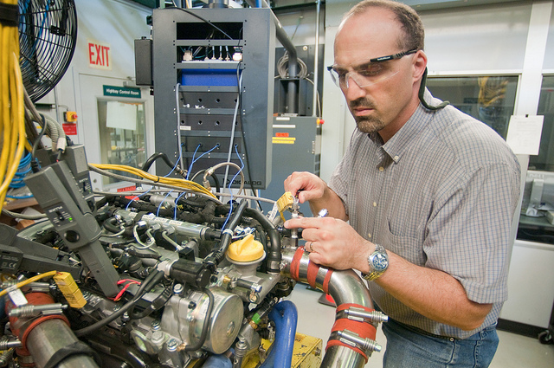
Notes:
Mechanical engineers do deal with motors and car engines but they also deal with robotics. How many of you like to build a robot that was remote controlled?

Slide 14
Biomedical Engineer
Analyze and design solutions to problems that are present in the biological and medical fields
Design of prosthesis and movement systems for people with spinal injuries
Biomedical Engineers must obtain a bachelor’s degree
Georgia Tech, UGA
Biomedical engineers work within universities, hospitals and research facilities.
The average pay for a this profession is $87,000 per year.
Notes:
Well has anyone ever wondered who designs prosthetic legs and arms for people who have lost limbs?
Biomedical engineers analyze and design solutions to problems that are present in the biological and medial fields
Along with prosthetics, they also create movement systems to help people with spinal injuries move around
Georgia Tech and UGA are two places within the state of Georgia where you can receive a bachelor’s degree in biomedical engineering. Places of employment require a bachelor’s degree.
Biomedical engineers make an average of $87,000 a year.

Slide 15
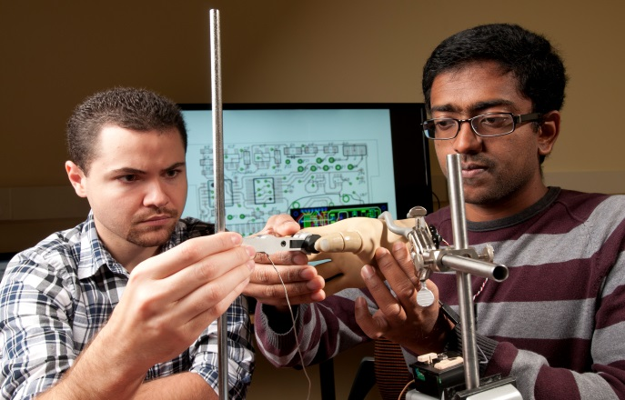
Notes:
Biomedical engineers deal with prosthetics as I mentioned before. You can see a few examples of these in these pictures
They also deal with genes and cloning. They can mix and match DNA to create different characteristics within species.

Slide 16
Group Project
Pick a partner
Choose an architectural or engineering profession to research
Notes:
Now that you have a brief understanding of these five jobs, I want you to partner off to complete a research project.
You will choose an architectural or engineering profession that you and your partner would like to research and in a few days you will give a class presentation about the job you chose.

